Slide 1
Solving problems by searching
Chapter 3

Slide 2
search strategies
Generic search approach:
  define a search space graph,
  start from current state,
  incrementally explore paths from current state until goal state is reached.

Slide 3
search strategies
A search strategy is defined by picking the order of node expansion
Strategies are evaluated along the following dimensions:
  completeness: does it always find a solution if one exists?
  time complexity: number of nodes generated
  space complexity: maximum number of nodes in memory
  optimality: does it always find a least-cost solution?
Time and space complexity are measured in terms of
  b: maximum branching factor of the search tree
  d: depth of the least-cost solution
  m: maximum depth of the state space (may be ∞)

Slide 4
A search algorithm is complete if, whenever at least one solution exists, the algorithm is guaranteed to find a solution within a finite amount of time.
A search algorithm is optimal if, when it finds a solution , it is the best solution
The time complexity of a search algorithm is an expression for the worst-case amount of time it will take to run, expressed in terms of the maximum path length m and the maximum branching factor b.
The space complexity of a search algorithm is an expression for the worst-case amount of memory that the algorithm will use (number of nodes), Also expressed in terms of m and b.

Slide 5
Uninformed search strategies
These searches use only the information available in the problem definition and systematically search complete graph, unguided
  Breadth-first search (BFS)
  Uniform-cost search (UCS)
  Depth-first search (DFS)
  Depth-limited search (DLS)
  Iterative deepening search
  Bi-directional search

Slide 6
Direction of search
Forward search: from start to goal
Backward search: from goal to start
Bidirectional search

Slide 7
BFS search
Expand shallowest unexpanded node, As the name BFS suggests, you are required to traverse the graph breadthwise as follows:
First move horizontally and visit all the nodes of the current layer
Move to the next layer

Slide 8
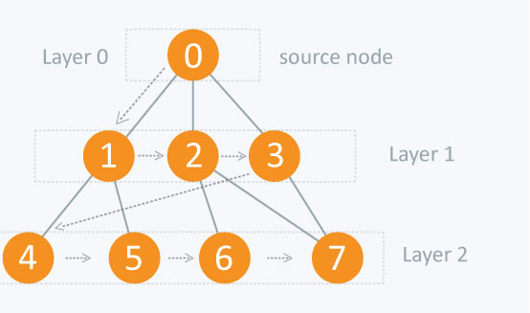
BFS search

Slide 9
Properties of Breadth-First Search
Complete
  Yes if b (max branching factor) is finite
Time
  1 + b + b² + … + b^{d} + b(b^{d}-1) = O(b^{d+1})
  exponential in d
Space
  O(b^{d+1})
  Keeps every node in memory
  This is the big problem; an agent that generates nodes at 10 MB/sec will produce 860 MB in 24 hours
Optimal
  Yes (if cost is 1 per step); not optimal in general

Slide 10
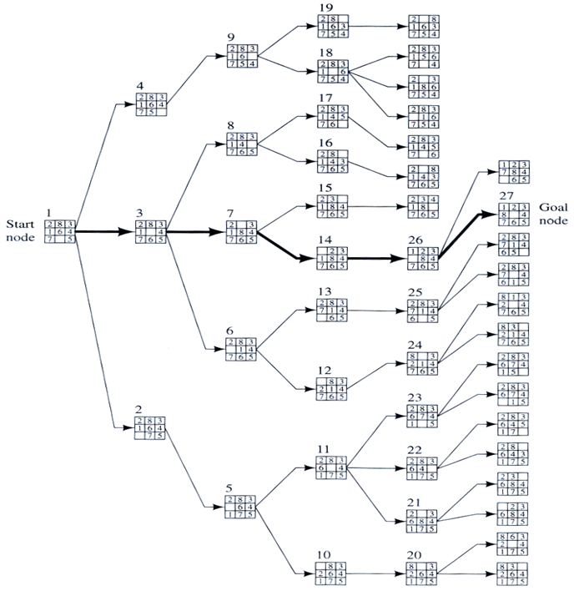
BFS

Slide 11
BFS
When is BFS appropriate?
  space is not a problem
  it's necessary to find the solution with the fewest arcs
  although all solutions may not be shallow, at least some are
  there may be infinite paths
When is BFS inappropriate?
  space is limited
  all solutions tend to be located deep in the tree
  the branching factor is very large

Slide 12
UCS
Same idea as the algorithm for breadth-first search…but…
  Expand the least-cost unexpanded node
  FIFO queue is ordered by cost
  Equivalent to regular breadth-first search if all step costs are equal

Slide 13
UCS
Complete
  Yes if the cost is greater than some threshold
  step cost >= ε
Time
  Complexity cannot be determined easily by d or d
  Let C* be the cost of the optimal solution
  O(b^{ceil(C*/ ε)})
Space
  O(b^{ceil(C*/ ε)})
Optimal
  Yes, Nodes are expanded in increasing order

Slide 14
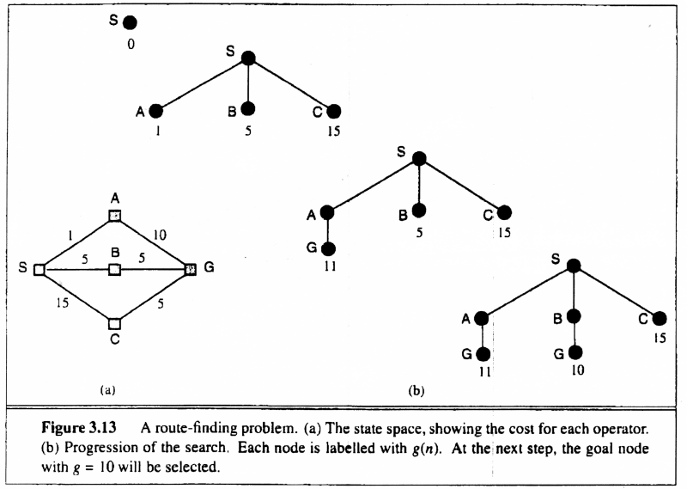
UCS

Slide 15
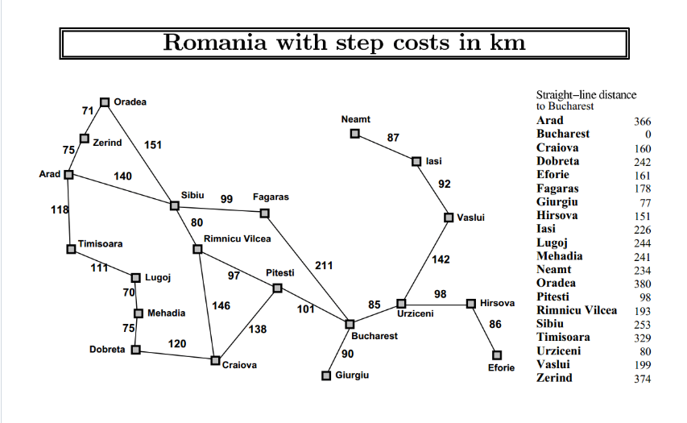

Slide 16
DFS
The DFS algorithm is a recursive algorithm that uses the idea of backtracking. It involves exhaustive searches of all the nodes by going ahead, if possible, else by backtracking.
Here, the word backtrack means that when you are moving forward and there are no more nodes along the current path, you move backwards on the same path to find nodes to traverse. All the nodes will be visited on the current path till all the unvisited nodes have been traversed after which the next path will be selected.

Slide 17
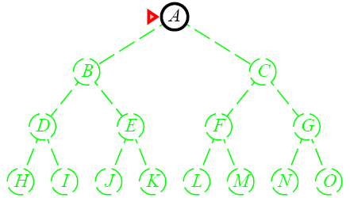
DFS
Expand the deepest unexpanded node
Unexplored successors are placed on a stack until fully explored

Slide 18
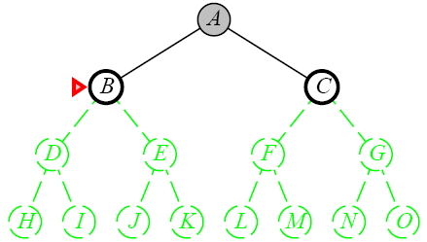
DFS
Expand the deepest unexpanded node
Unexplored successors are placed on a stack until fully explored

Slide 19
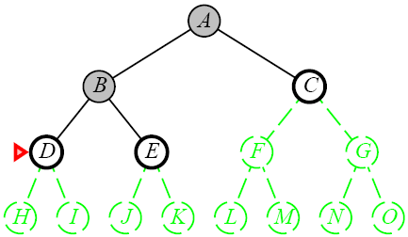
DFS
Expand the deepest unexpanded node
Unexplored successors are placed on a stack until fully explored

Slide 20
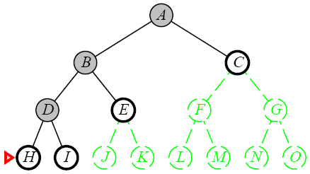
DFS
Expand the deepest unexpanded node
Unexplored successors are placed on a stack until fully explored

Slide 21
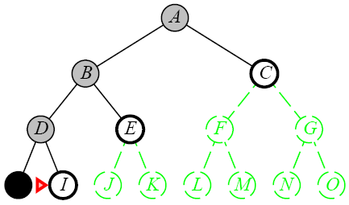
DFS
Expand the deepest unexpanded node
Unexplored successors are placed on a stack until fully explored

Slide 22
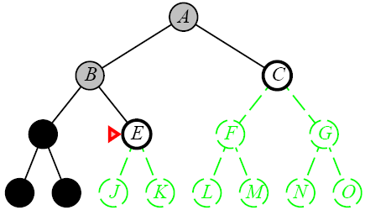
DFS
Expand the deepest unexpanded node
Unexplored successors are placed on a stack until fully explored

Slide 23
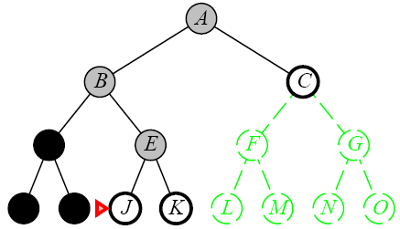
DFS
Expand the deepest unexpanded node
Unexplored successors are placed on a stack until fully explored

Slide 24
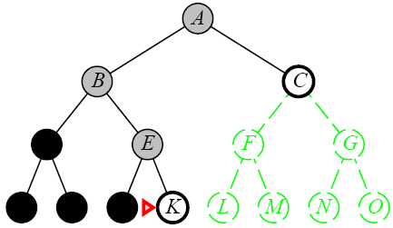
DFS
Expand the deepest unexpanded node
Unexplored successors are placed on a stack until fully explored

Slide 25
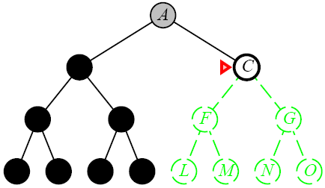
DFS
Expand the deepest unexpanded node
Unexplored successors are placed on a stack until fully explored

Slide 26
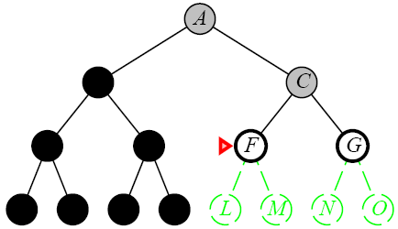
DFS
Expand the deepest unexpanded node
Unexplored successors are placed on a stack until fully explored

Slide 27
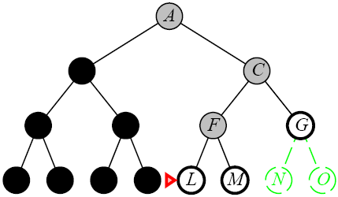
DFS
Expand the deepest unexpanded node
Unexplored successors are placed on a stack until fully explored

Slide 28
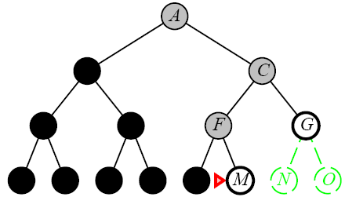
DFS
Expand the deepest unexpanded node
Unexplored successors are placed on a stack until fully explored

Slide 29
DFS
When is DFS appropriate?
  Space is restricted (complex state representation e.g., robotics)
  There are many solutions, perhaps with long path lengths, particularly for the case in which all paths lead to a solution
When is DFS inappropriate?
  Infinite / cycles
  There are shallow solutions

Slide 30
Properties of Depth-First Search
Complete
  No: fails in infinite-depth spaces, spaces with loops
    Modify to avoid repeated spaces along path
  Yes: in finite spaces
Time
  O(b^{m})
  Not great if m is much larger than d
  But if the solutions are dense, this may be faster than breadth-first search
Space
  O(bm)…linear space
Optimal
  No

Slide 31
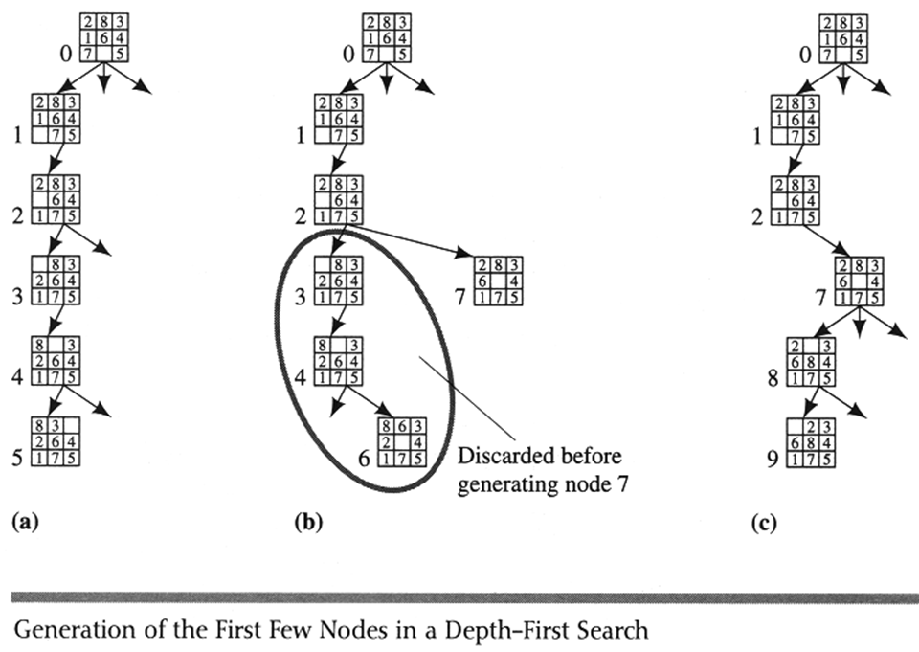
DFS

Slide 32
To avoid the infinite depth problem of DFS, we can decide to only search until depth L, i.e. we don’t expand beyond depth L.
→ Depth-Limited Search
What of solution is deeper than L? → Increase L iteratively.
→ Iterative Deepening Search
As we shall see: this inherits the memory advantage of Depth-First search.

Slide 33
DLS
A variation of depth-first search that uses a depth limit
  Alleviates the problem of unbounded trees
  Search to a predetermined depth l (“ell”)
  Nodes at depth l have no successors
Same as depth-first search if l = ∞
Can terminate for failure and cutoff

Slide 34
DLS
Complete
  Yes if l < d
Time
  O(b^{l})
Space
  O(bl)
Optimal
  No if l > d

Slide 35
IDS
Iterative deepening depth-first search
  Uses depth-first search
  Finds the best depth limit
    Gradually increases the depth limit; 0, 1, 2, … until a goal is found

Slide 36
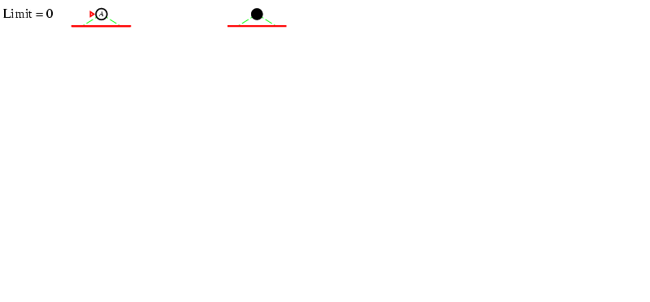
Iterative deepening search l =0

Slide 37
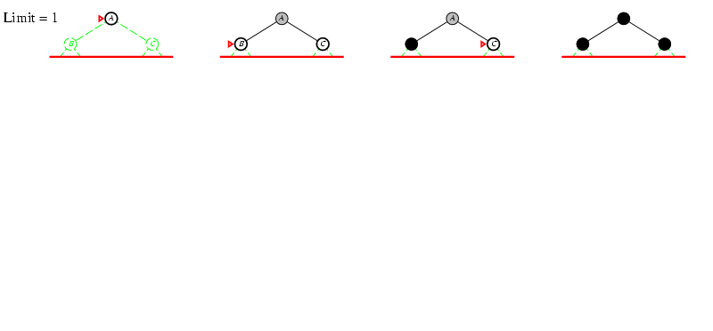
Iterative deepening search l =1

Slide 38
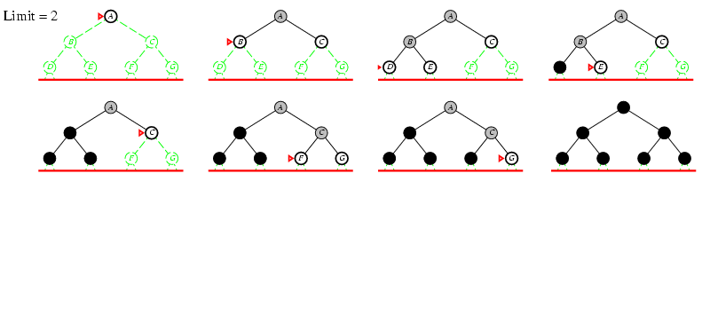
Iterative deepening search l =2

Slide 39
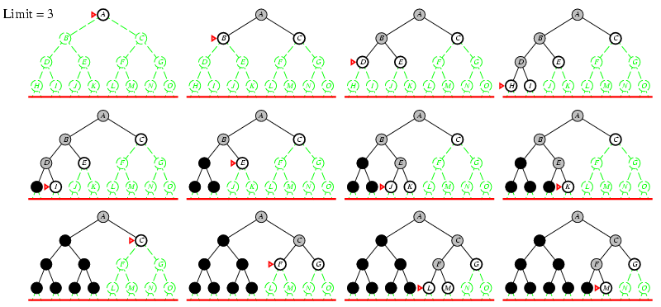
Iterative deepening search l =3

Slide 40
IDS
Complete
  Yes
Time
  O(b^{d})
Space
  O(bd)
Optimal
  Yes if step cost = 1
  Can be modified to explore uniform cost tree

Slide 41
Avoiding repeated states
Complication of wasting time by expanding states that have already been encountered and expanded before
  Failure to detect repeated states can turn a linear problem into an exponential one
Sometimes, repeated states are unavoidable
  Problems where the actions are reversable
    Route finding
    Sliding blocks puzzles

Slide 42
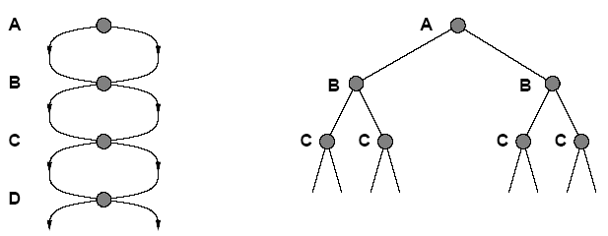
Avoiding repeated states
Search Tree
State Space

Slide 43
Bidirectional
Idea
  simultaneously search forward from S and backwards from G
  stop when both “meet in the middle”
  need to keep track of the intersection of 2 open sets of nodes
What does searching backwards from G mean
  need a way to specify the predecessors of G
    this can be difficult,
    e.g., predecessors of checkmate in chess?
  what if there are multiple goal states?
  what if there is only a goal test, no explicit list?

Slide 44
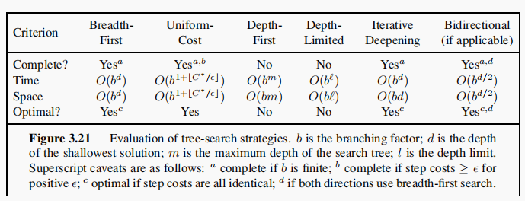
Evaluation

